Slide 1

IMDB MOVIE RECOMMENDER
Priyanka Bijlani, Sharmeelee Bijlani, Laura Thriftwood, Lakshmi Venkatasubramanian

Slide 2
Project Overview and Dataset
We created a movie recommendation system that uses a Collaborative Filtering algorithm trained on a rich dataset of movie titles and user ratings. It's based on the idea that people who agreed in their evaluation of shared movies are likely to agree again in the future.
As you’ll see, this predictive algorithm is used to provide a list of recommended movies for a inputted user or provide a list of movies similar to an inputted movie.
The dataset is from MovieLens and contains over 100k ratings, 1700 movie titles, and 1000 users.

Slide 3
Use Cases
Predicted Ratings
Similar Movies
Movie Recommendation for a User

Slide 4
Design
Data Source
Data Manager
Data Processor
Model
Evaluate Model
Recommender
Test Model
Score Model
Movie Lens Zip File
Process data
Recommend Movie for User
Extract data
Train Model
Recommend Similar Movies by Movie
Predict Movie Ratings by User

Slide 5
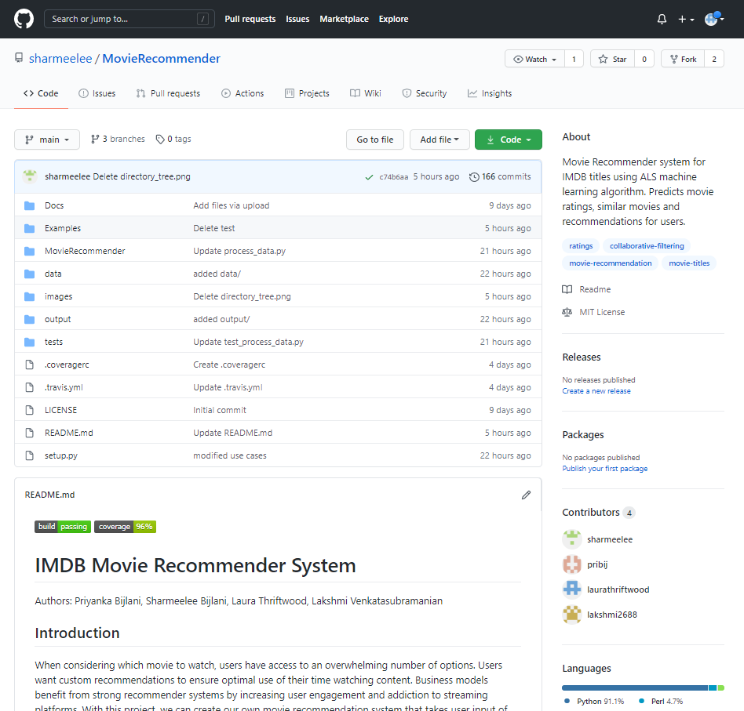
GitHub Repository

Slide 6
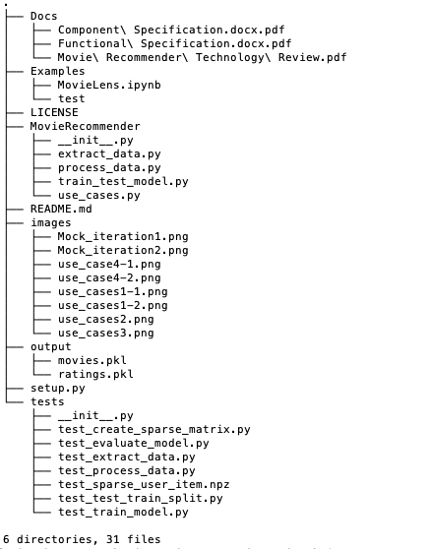
GitHub Project Structure

Slide 7

DEMO

Slide 8
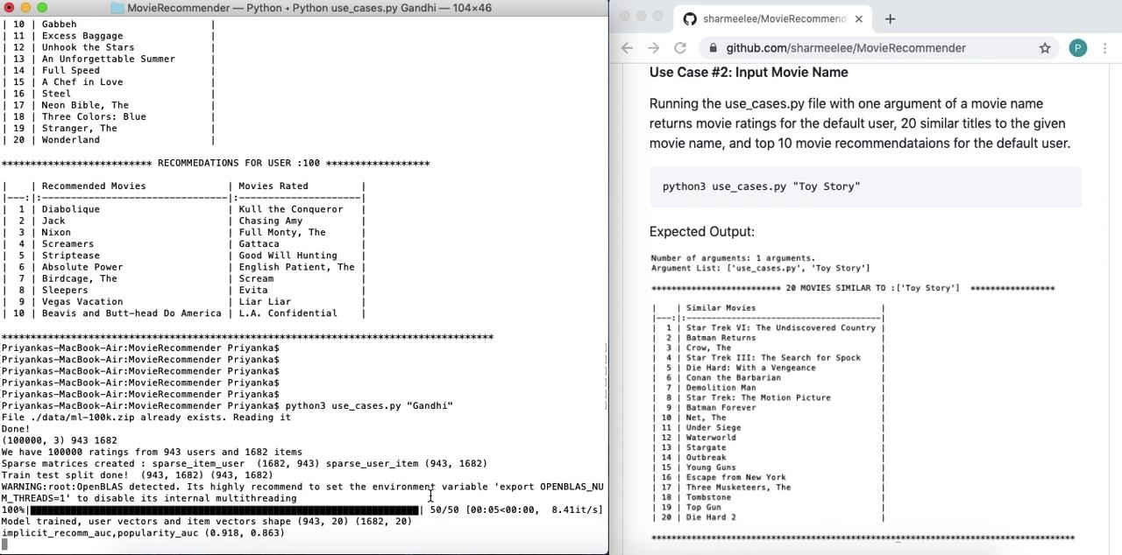

Slide 9


Future Work
Create Live Movie-Rating Database
Create a Website
Users can add themselves to database
Separate frontend and backend

Slide 10
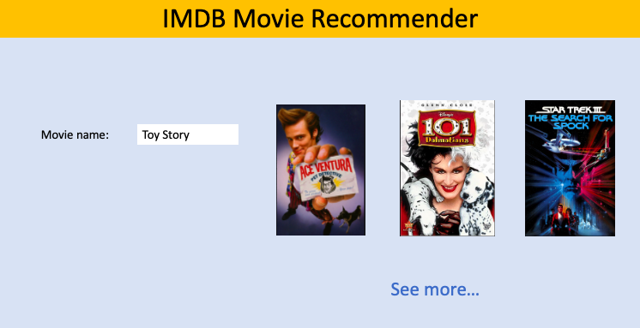
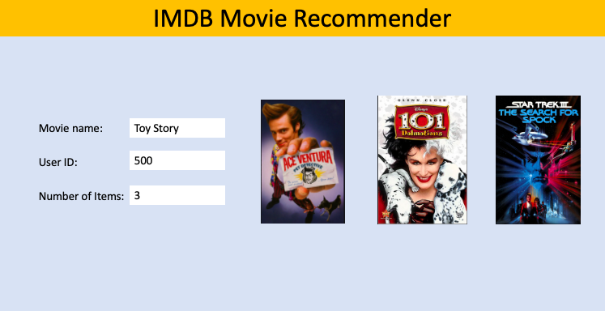
Mock GUI

Slide 11
Lessons Learned
Unit Testing and Code Development should happen side-by-side
CI is very helpful in ensuring the code does not break with frequent updates and changes
Time constraints and Scope

